Slide 1
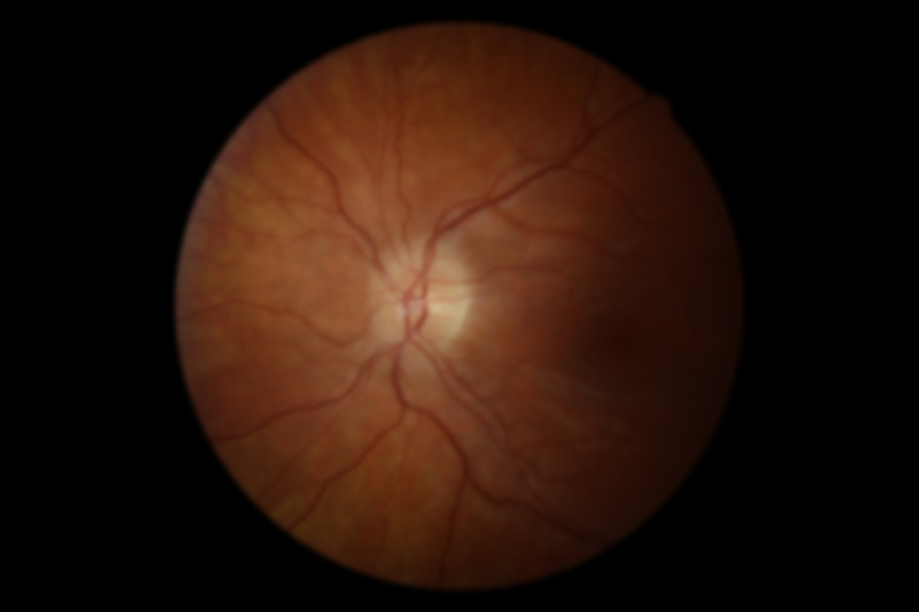
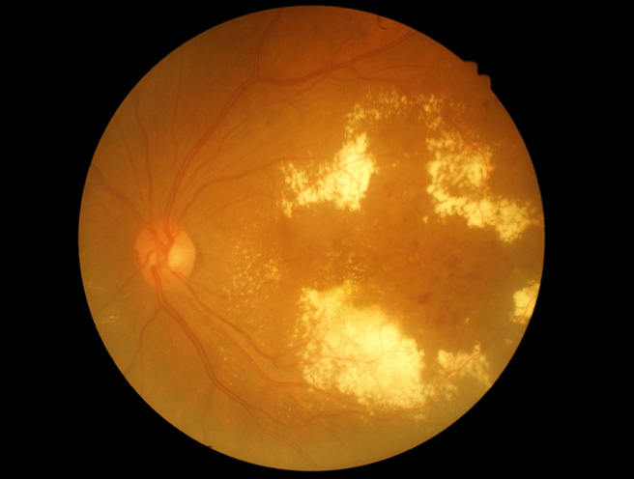
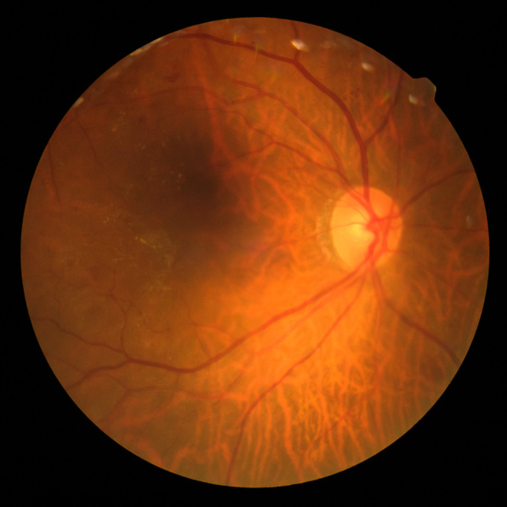
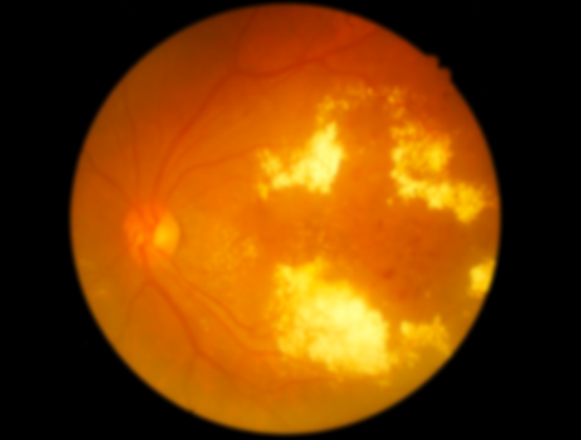

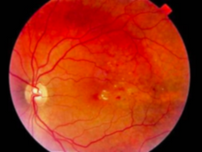
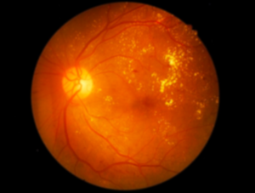
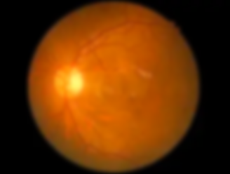
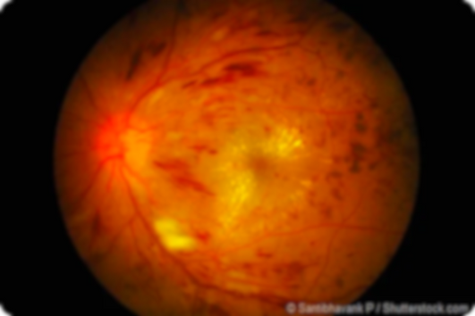
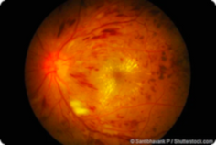
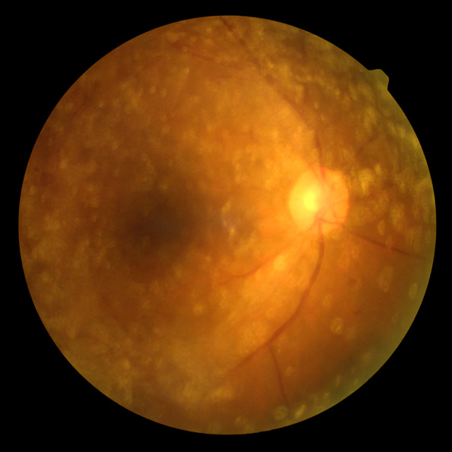
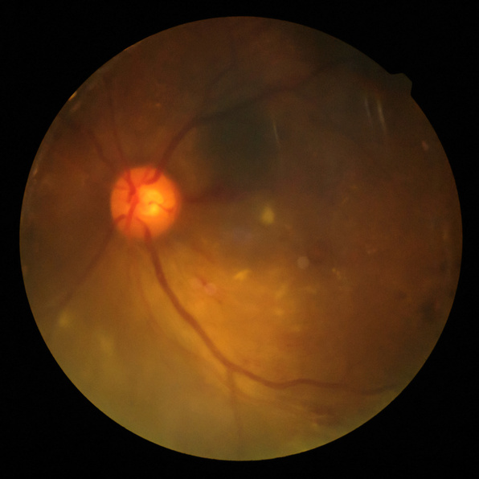
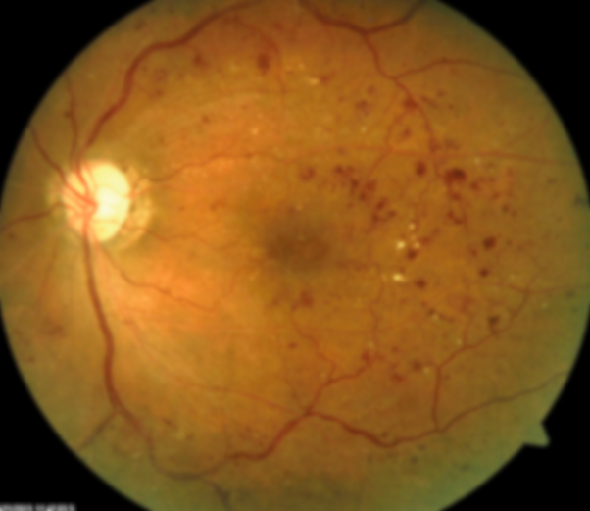
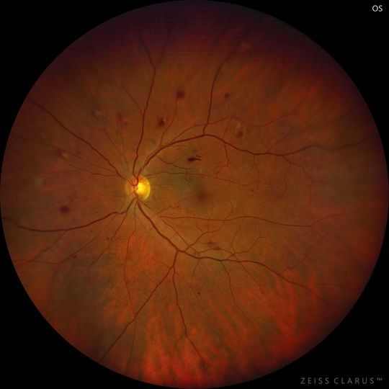
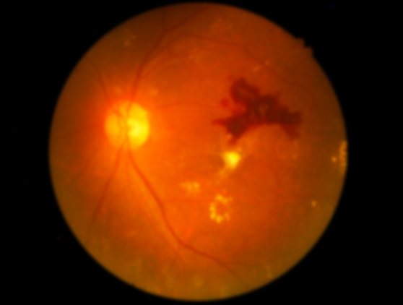
Student
Yiyang (Jessie) Yu
Supervisor
Andrew Bainbridge-Smith
Machine Learning
Diabetic Eye Health
For Diagnosing
Risk of losing sight
Notes:
KIA ORA TATOU
KO RANGITOTO TE MAUNGA,
KO TAKAPUNA TE MOANA,
KO HĀTEA TE AWA,
NO WHANGĀREI AHAU,
KO YU TOKU WHANAU,
KO YIYANG TOKU INGOA,
Kia ora all, I’m Yiyang Yu and I’ve been working with my supervisor Andrew Bainbridge-Smith on a project to use machine learning to diagnose diabetic eye health.

Slide 2
Machine Learning
Diabetic Eye Health
For Diagnosing
Risk of losing sight
Leading cause of preventable blindness in the world
Notes:
And Why am I even doing this?
It’s because anyone with diabetes have risk of getting damage to their eyes,
leaving this complication untreated means the continuous eye damage can lead to blindness.

Slide 3
Machine Learning
Diabetic Eye Health
For Diagnosing
Risk of losing sight
Leading cause of preventable blindness in the world
By 2040, over
600 million
people with diabetes will
require regular eye checks
Notes:
this disease, called Diabetic retinopathy is a leading cause of preventable blindness in the world.
Preventable key word meaning we can do something about it and make a huge impact
Because just through early detection, we are able to swoop in with medical treatment asap to save people’s vision

Slide 4
Leading cause of preventable blindness in the world
Risk of losing sight
By 2040, over
600 million
people with diabetes will
require regular eye checks
Notes:
Sadly, there number of people with diabetes, and hence the number of people we need to screen for diabetic retinopathy is increasing,
it’s crucial to ensure that the future of our health system can expand to continue providing access to their needed eye checks

Slide 5
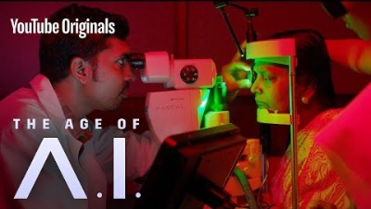
Notes:
Now imagine this
imagine if this was our reality a tool to give diagnosis in real time, like getting your weight, which was dream outcome for this exact problem
https://youtu.be/V5aZjsWM2wo?t=1347

Slide 6
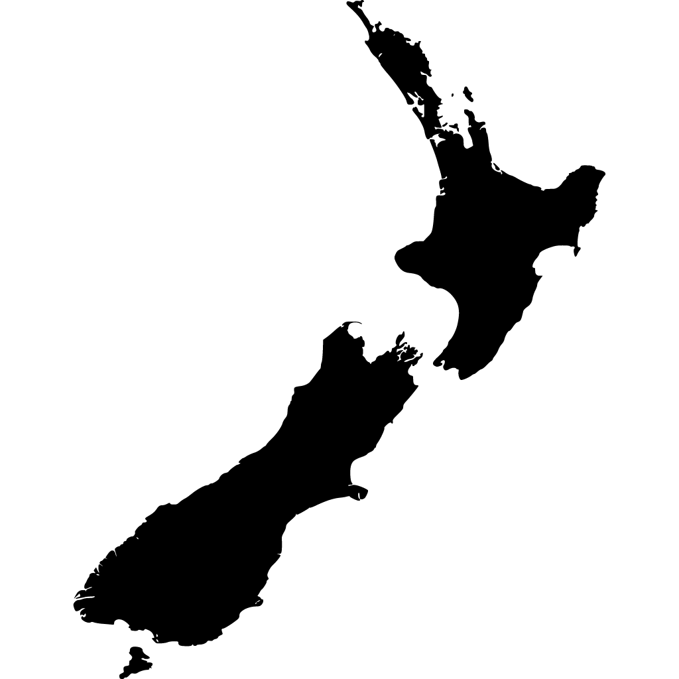



Currently in NZ
Notes:
imagine if this was our reality a tool to give diagnosis in real time, which was dream outcome for our real world problem
currently, here is a diabetic epidemic in NZ (esp for the maori population), more people need diagnosis than ever
New Zealand’s current manual screening process is slow and relies on professionals to read images accurately, causing a stressful bottleneck to the number of patients the system needs to expand to manage.
Imagine if we can have this dream tool for nz for more equitible screening access

Slide 7
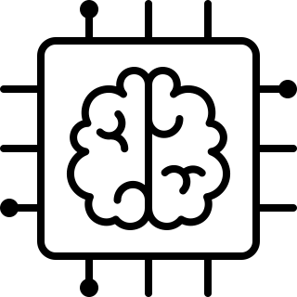
Objective
Use machine learning to automate NZ’s diabetic retinopathy (DR)
screening process
Notes:
My project’s objective is to create a machine learning model to automate diagnosing diabetic retinopathy so a proof of concept of how we can use tech in NZ to increase prompt access to vision-saving eye screenings

Slide 8
Plan
Model
Notes:
So how can we make this happen
my goal is to create that machine learning model, but that requires a large set of data

Slide 9
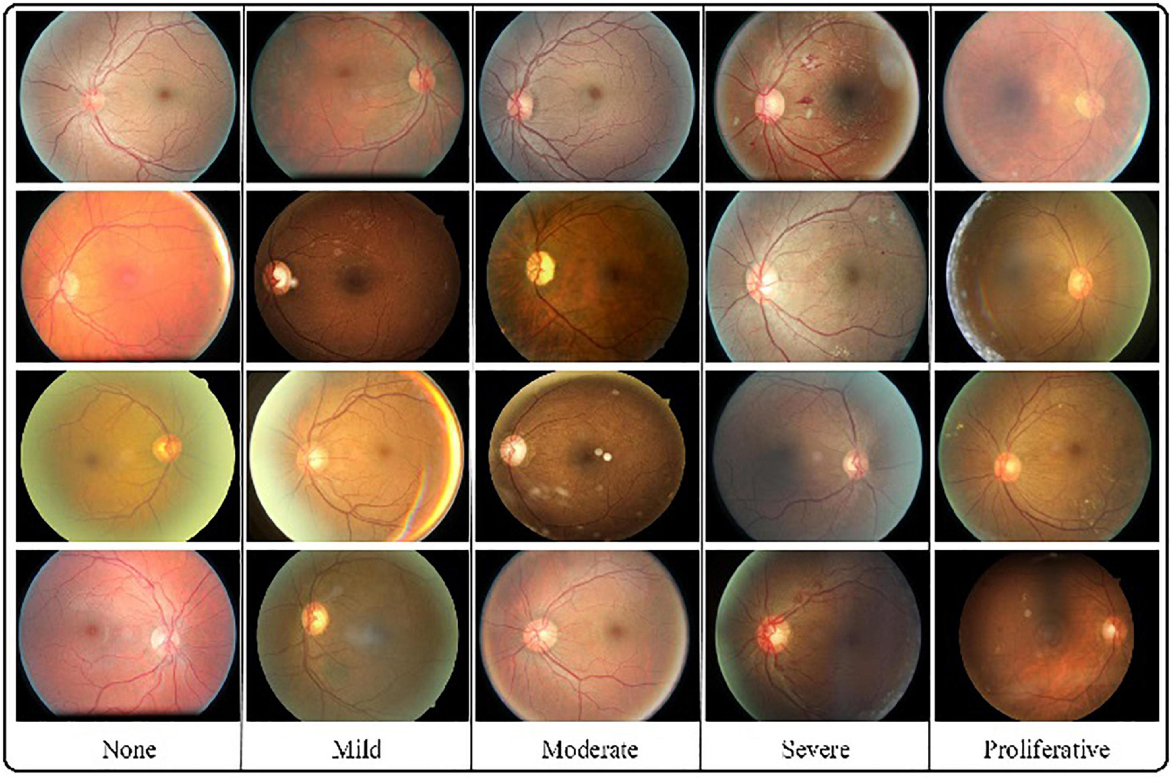
Plan
Model
Data
Notes:
A good machine learning model is trained on a large dataset. The more data we have, the more variety to accurately represent the real world and learn patterns from and make predictions for future data examples.
so we need a model, we need data
how can i acquire this data??

Slide 10
Plan
Canterbury District Health
Model
Data
Notes:
fortunaely the CDHB provided a large dataset of 3-4000 retinal images, which help overcome the first step of making sure we have large quantity
another good news is, past students who were also working on this as a final year project have worked on quality assurance so the quantity and quality has already been ensured
but theres a catch

Slide 11
Plan
Canterbury District Health
Model
Data
Labelled
Notes:
we can't just use these images yet, as they are not labelled.
you see we can create a model for predictions, but how do we even know its making the correct predictions. i personally also don't know for obvious reasons that i am not a doctor. i can;t make any diagnosis calls
we need medical professionals, who are the domain experts to advise on what the actual expected outcome should be. and they do this by labelling the data of its correct prediction
so we need a mode, the data, that is already labelled
sourcing medical experts for labelled, who are already pretty busy, was a risky dependency identified and so mitigation were put in place from the begining of the project,

Slide 12
Plan
Canterbury District Health
University of Auckland
Model
Data
Labelled
Notes:
THRO literature review I found a handful of other retinal images that are labelled so loads of backup datasets if the canterbury one fall through.
One of them was the auckland uni dataset, which is also relevant for kiwis.

Slide 13

Plan
Canterbury District Health
University of Auckland
Model
Data
Labelled
Notes:
and it was true, it was logistically difficult to get medical experts to label loads and loads of data…
so this was cancelled
thank goodness this challenge was scoped so the proof of concept had hope

Slide 14


Plan
Canterbury District Health
University of Auckland
Model
Data
Labelled
Notes:
we pursue getting access to it the Auckland uni dataset, which although had less quantity, it was labelled.

Slide 15
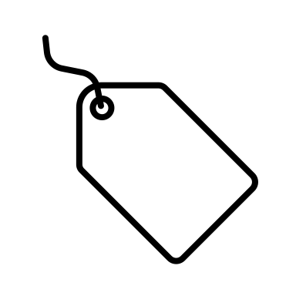
Plan
Canterbury District Health
University of Auckland
Model
Data
Labelled
Notes:
We had labelled data

Slide 16
Plan
Canterbury District Health
University of Auckland
Model
Data
Labelled
Notes:
and we were able to use the labelled data for training a deep learning model!

Slide 17
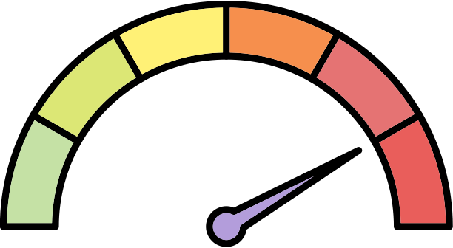
Solution
2
3
1
4
0
5
Input retinal image
Output DR grade:
Healthy - 0
Minimal DR - 1
Mild DR - 2
Moderate DR - 3
Severe DR - 4
Proliferative DR - 5
Notes:
I have my retina images to input into my model and output the severity of diabetic retinopathy on a scale from 0 – 5 according to the nz Ministry of Health making my model speciifc to NZ needs and a multi class image classification problem.
Work done in this field showed promise with using tranfer learning, which is a technic using pre-trained models that are already doing a great job at detecting lines, points in your images, and what not, so with the pre-trained model, you just fine-tuning them for our speicifc task,

Slide 18
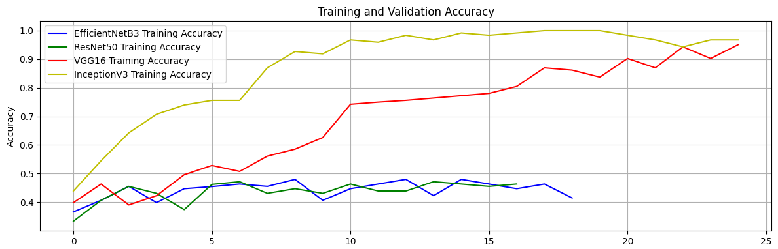
Evaluation
<95% accuracy in predicting DR grades.
Notes:
experimented with multiple pre-trained models, which is a good practice to find the best model architecture for our specific problem.
We also implemtned early stopping callback to prevent overfitting, which is crucial for maintaining model generalization.
Seems like models are performing reasonably well in terms of accuracy with VGG16 and Inception and with a 95% or more accuracy and this measures up with research in this field already.
However
accuracy not the only metric to consider when evaluating a medical image classification model in future research willl dive into evaluating, precision-recall, F1 score, and confusion matrix,
multi-class classification problem, may want to calculate class-specific metrics to assess the model's performance on each class
evaluate the model's performance on a canetebrury db in future to validate its generalization capabilities.

Slide 19
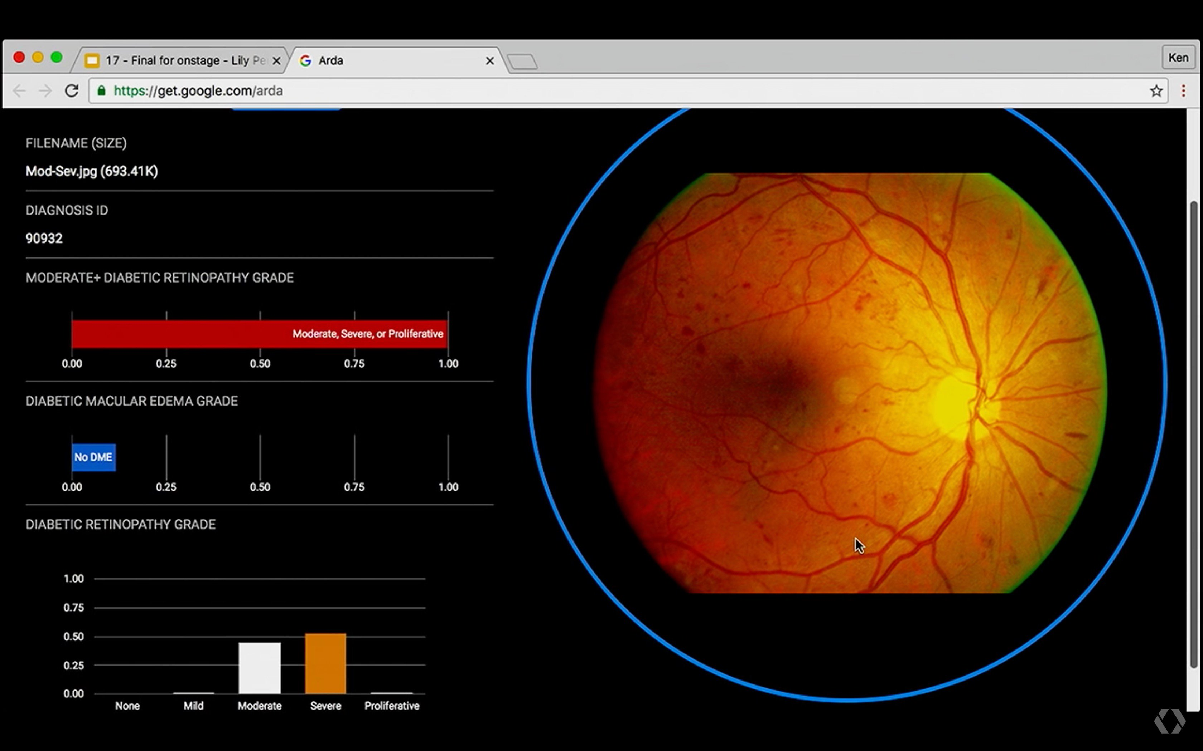
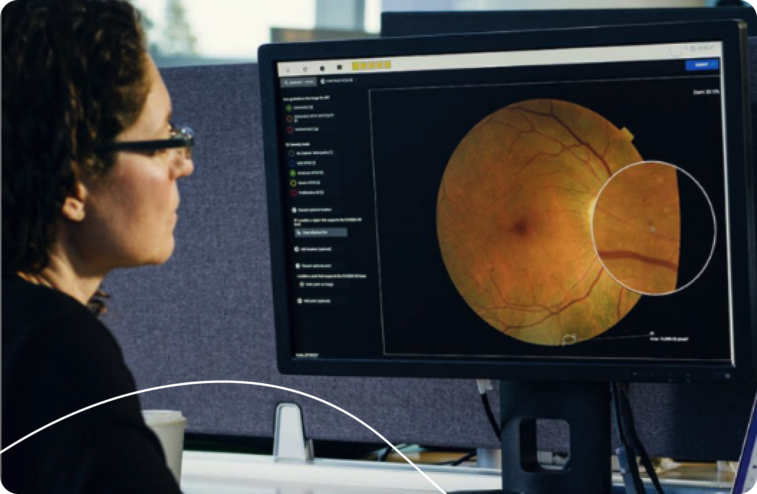
Notes:
The video at the beginning is not just in imgainations, its not science fiction, it is science fact and the reality for people in india,
Implementing a proof of concept for new Zealanders is a promising start for detecting diabetic retinopathy specifically for our population.
However, to provide a more comprehensive evaluation and achieve real-world application, ill suggestion future research to delve deeper into a more extensive analysis of the model's performance, including additional metrics and clinical validation.

Slide 20
THANK YOU
Any questions?

Slide 21

Plan
ML model
Data
Quality
Labelled
Notes:
Now how does our data look

Slide 22

Plan
ML model
Data
Quality
Labelled

Slide 23
Plan
ML model
Data
Quality
Quantity
Labelled
Notes:
risk was identified and mitigation were put in place,
and it was true, it was logistically difficult to get medical experts to label loads and loads of data…
so this was cancelled
because thro literature review I found loads of backup datasets already existing.
decided UoA coz nz dataset
Plan B proof of concept with but with just the the UoA data.

Slide 24


Plan
ML model
Data
Quality
Quantity
Labelled

Slide 25

Plan
ML model
Data
Quality
Quantity
Labelled

Slide 26
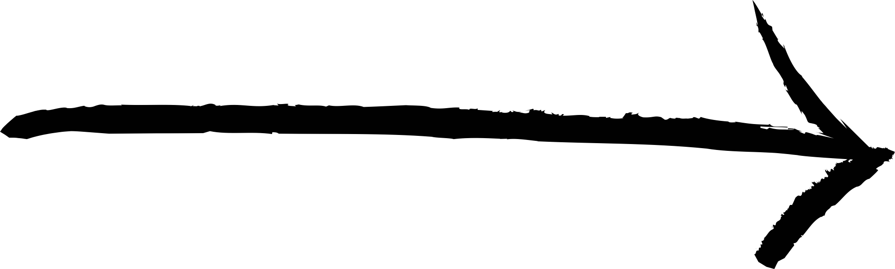


1. Retinal image.
2. Upload to web.
3. Input to model.
DR grade scale recommended by the Ministry of Health NZ.
0 - Healthy
1 - Minimal DR
2 - Mild DR
3 - Moderate DR
4 - Severe DR
5 - Proliferative DR
4. Output prediction.
5. DR grade
2
3
1
4
0
5

